Slide 1
Technical Communication & Content Writing
-3501 Dhruvi Swadia
-3506 Aishani Anavkar
-3519 Samriddhi Sharma
-3538 Om Bhosle
-3545 Samreen Shaikh

Slide 2

Virtual Chatbot using Python

Slide 3
01
02
What are Chatbots?
What are Chatbots used for?
03
04
Why are Chatbots important?
Types of Chatbots.

Slide 4
What are Chatbots?
A chatbot (derived from “chat robot”) is a computer program that simulates human conversation, either via voice or text communication.
There are a number of synonyms for chatbot, including "talkbot," "bot," "IM bot,"
Chatbot is an automated program that interacts with customers like a human would and cost little to nothing to engage with.

Slide 5
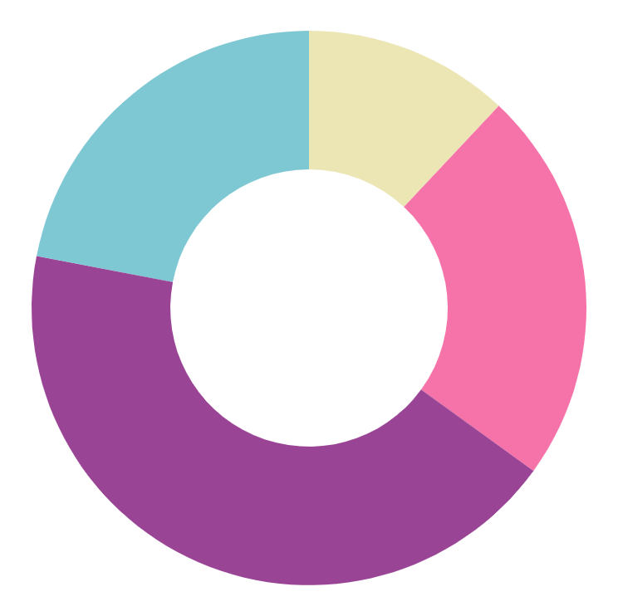
What Chatbots used for?
With chatbots, people can have a conversation with a person (a sales rep or a support agent, for instance), or interact with a software program that helps them find answers quickly.
This tool helps add convenience for customers
Chatbots attend to customers at all times of the day and week and are not limited by time or a physical location.
Key examples are chatbots used by businesses in Facebook messenger, or as virtual assistants, such as Amazon's Alexa.

Slide 6

Why are Chatbots important?
It reduces customer waiting time- 21% see chatbots as the easiest way to contact a business
24x7 availability- Bots are always available to engage with customers
Better customer engagement- It offers personalized recommendations that boost customer experience
Save customer service cost- They are easily scaled
which saves customer support
Automate lead qualifications & sales- Being able to engage
with customers increases the number of leads

Slide 7
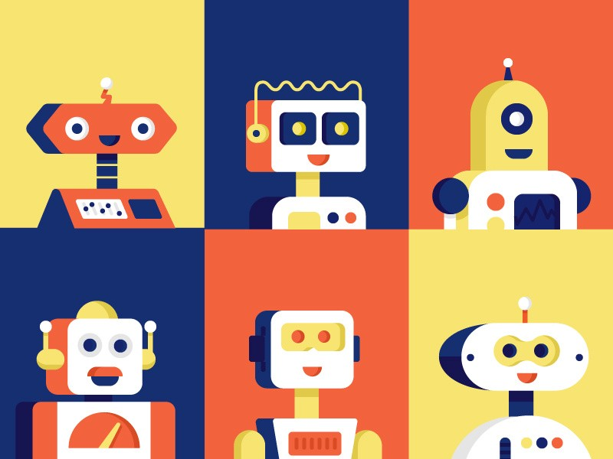
A chatbot that functions with a set of guidelines in place is limited in its conversation. It can only respond to a set number of requests and vocabulary and is only as intelligent as its programming code.
A chatbot that functions through machine learning has an artificial neural network inspired by the neural nodes of the human brain. It is programmed to self-learn as a chatbot receives new voice or textual dialogues, the number of inquiries that it can reply and the accuracy of each response it gives increases.
Types of Chatbots
Set Guidelines Chatbot:
Machine Learning Chatbot:

Slide 8
Benefits of Chatbots
Improve customer engagement and brand loyalty
Reduce costs and boost operational efficiency
Generate leads and satisfy customers
-Can consistently manage customer interactions 24x7 while continuously improving the quality of the responses and keeping costs down. Chatbots automate workflows and free up employees from repetitive tasks.
-Can answer questions 24 hours a day, seven days a week. It can provide a new first line of support, supplement support during peak periods, or offer an additional support option.
-Can help with sales lead generation and improve conversion rates. A chatbot can provide these answers, helping the customer decide which product or service to buy or take the next logical step toward that final purchase.

Slide 9
Let’s have a look at the code

Slide 10
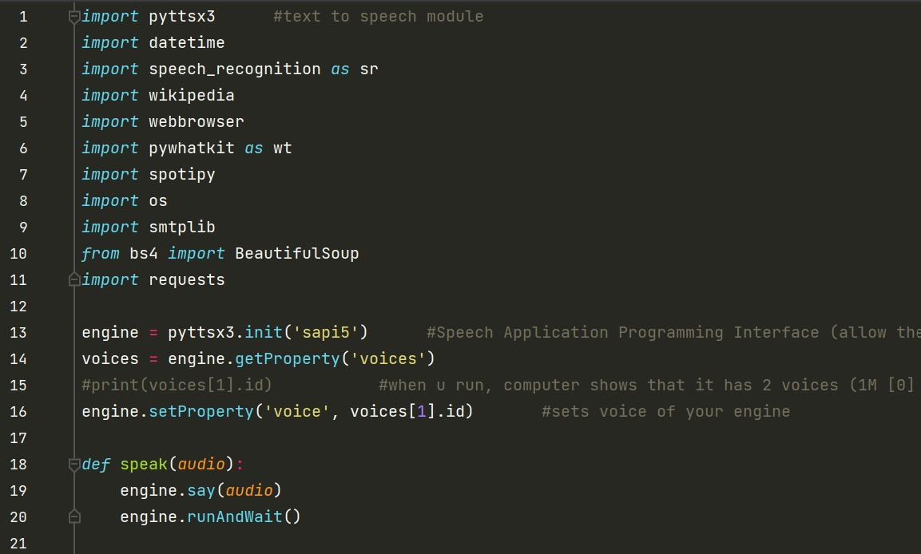
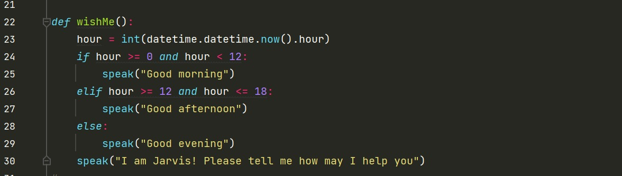
fpyttsx3 is a text-to-speech conversion library in Python.
Datetime module supplies classes to work with date and time.
Speech recognition helps us to save time by speaking instead of typing. It also gives us the power to communicate with our devices without even writing one line of code.
The Python Wikipedia module allows us to search a query supplied as argument using the search() method. This method returns a list of all articles that contain the searched query.
The web browser module provides a high-level interface to allow displaying Web-based documents to users.
Following are some features of pywhatkit module:
Send WhatsApp messages.
The OS module in Python provides functions for interacting with the operating system.
The smtplib module defines an SMTP client session object that can be used to send mail to any Internet machine with an SMTP or ESMTP listener daemon.

Slide 11
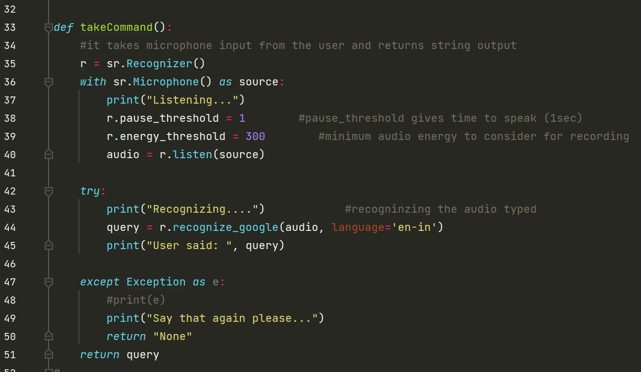
The try except statement can handle exceptions. Exceptions may happen when you run a program. The idea of the try-except clause is to handle exceptions (errors at runtime).
Exceptions are errors that happen during execution of the program.
This program will record audio from your microphone, send it to the speech API and return a Python string. The audio is recorded using the speech recognition module, the module will include on top of the program.
(a new point)

Slide 12
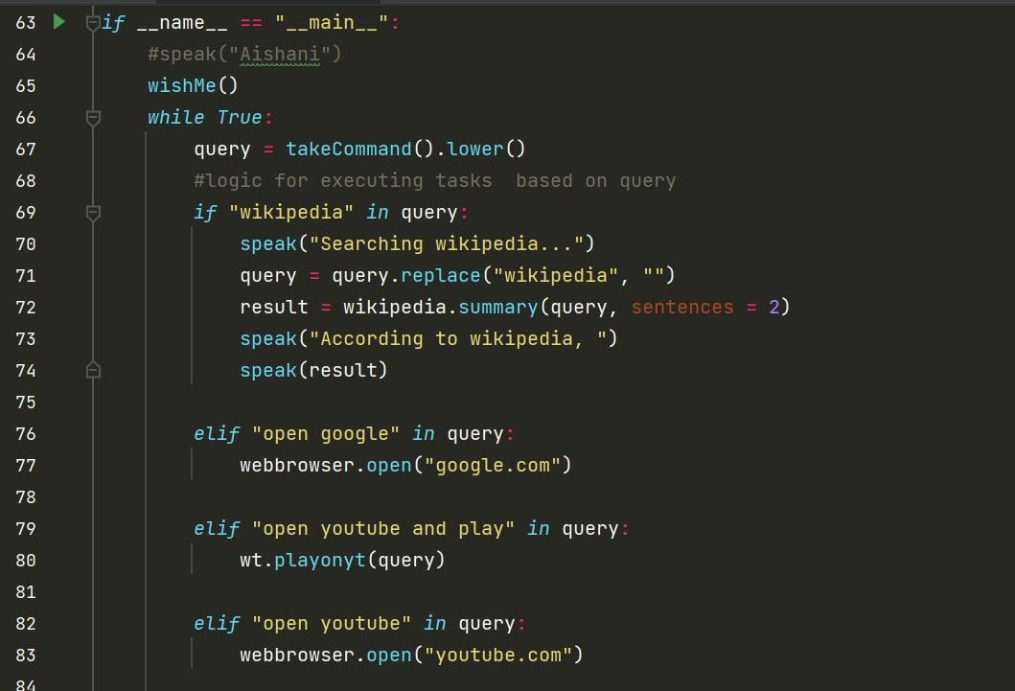
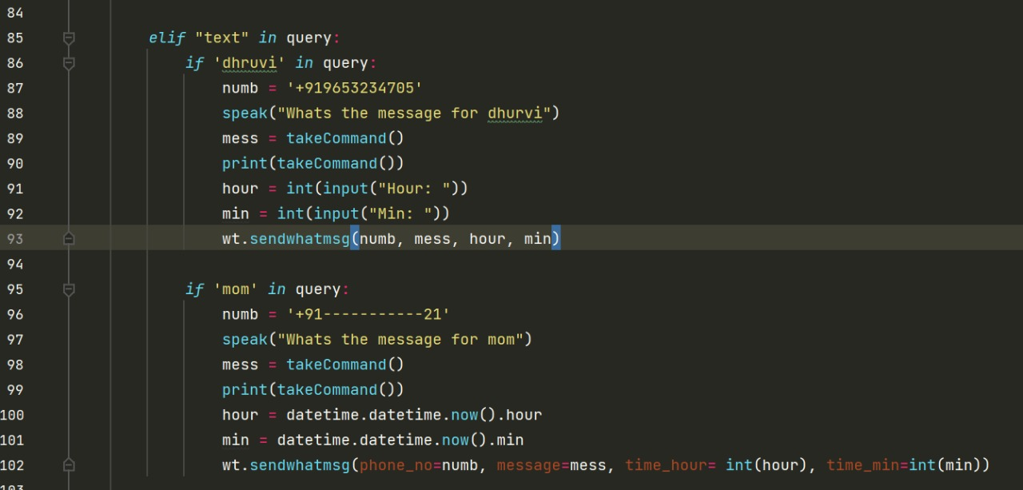
vvvv
Wikipedia: Python’s library that makes it easy to access and parse data from Wikipedia.
The datetime: module supplies classes for manipulating dates and times.
The strftime(): function is used to convert date and time objects to their string representation.
Using other sources like google and YouTube, our chatbot Jarvis can easily launch the webpage through our voice detection.
We have imported pywhatkit for sending whatsapp message at a certain time.
Using our AI chatbot Jarvis, we can easily send any message to others just by enunciating our voice through it.

Slide 13
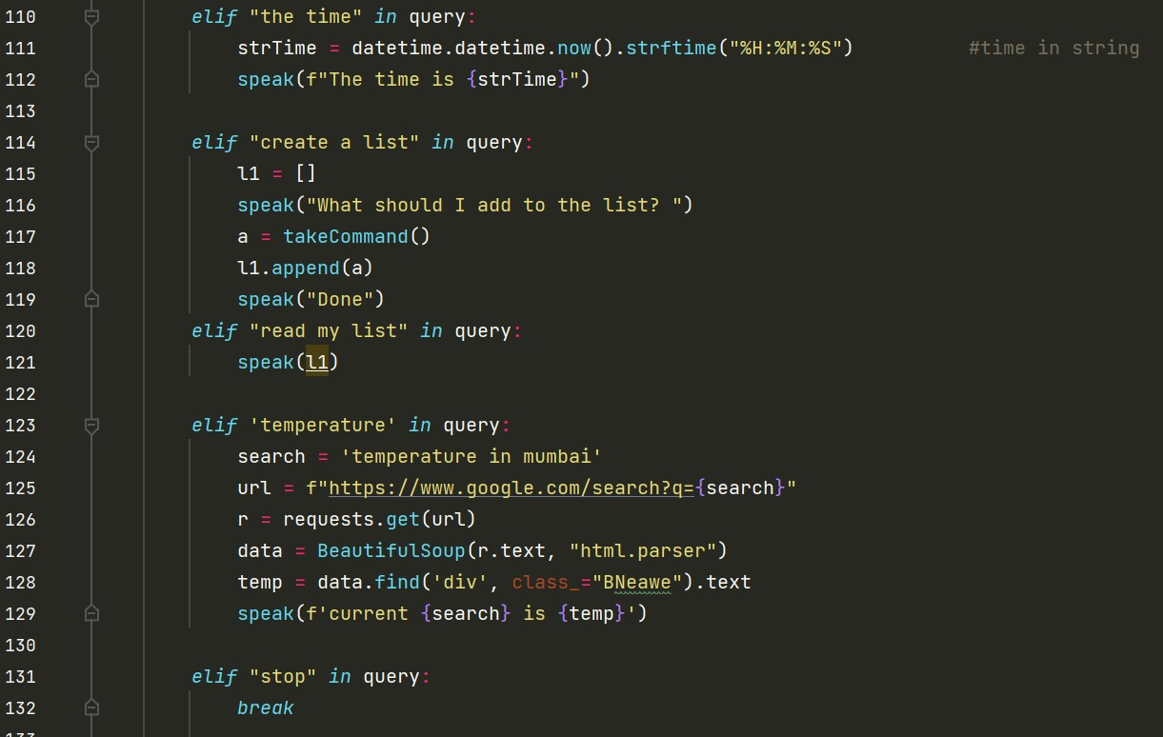
Formatting is a process in which you define the layout of elements for display.
Python DateTime formatting is the process of generating a string with how the elements like day, month, year, hour be displayed in a string
For example, displaying the date as DD-MM-YYYY is a format, and displaying the date as MM-DD-YYYY is another format.
To format DateTime, we will use strftime() function on the datetime object. strftime() is the short for string format time.
Python offers a range of compound data types often referred to as sequences.
List is one of the most frequently used and very versatile data types used in Python.

Slide 14
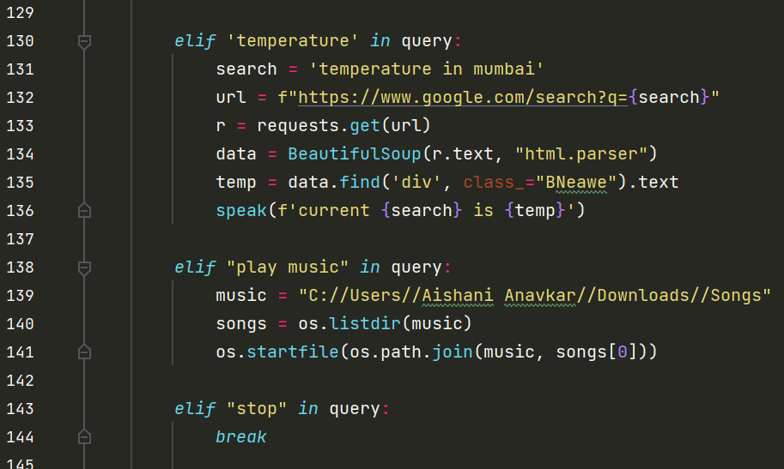
The requests module in Python allows you to exchange requests on the web.
BeautifulSoup is a Python library that is used for web scraping purposes to pull the data out of HTML and XML file.
The OS module in Python provides functions for interacting with the operating system.
A folder containing downloaded songs is created.
The os.listdir() method in python is used to get the list of all files and directories in the specified directory.
It’s path is added so that JARVIS can access it.
The os.startfile() method allows us to “start” a file with its associated program.

Slide 15
Let’s have a look at the live demonstration.

Slide 16
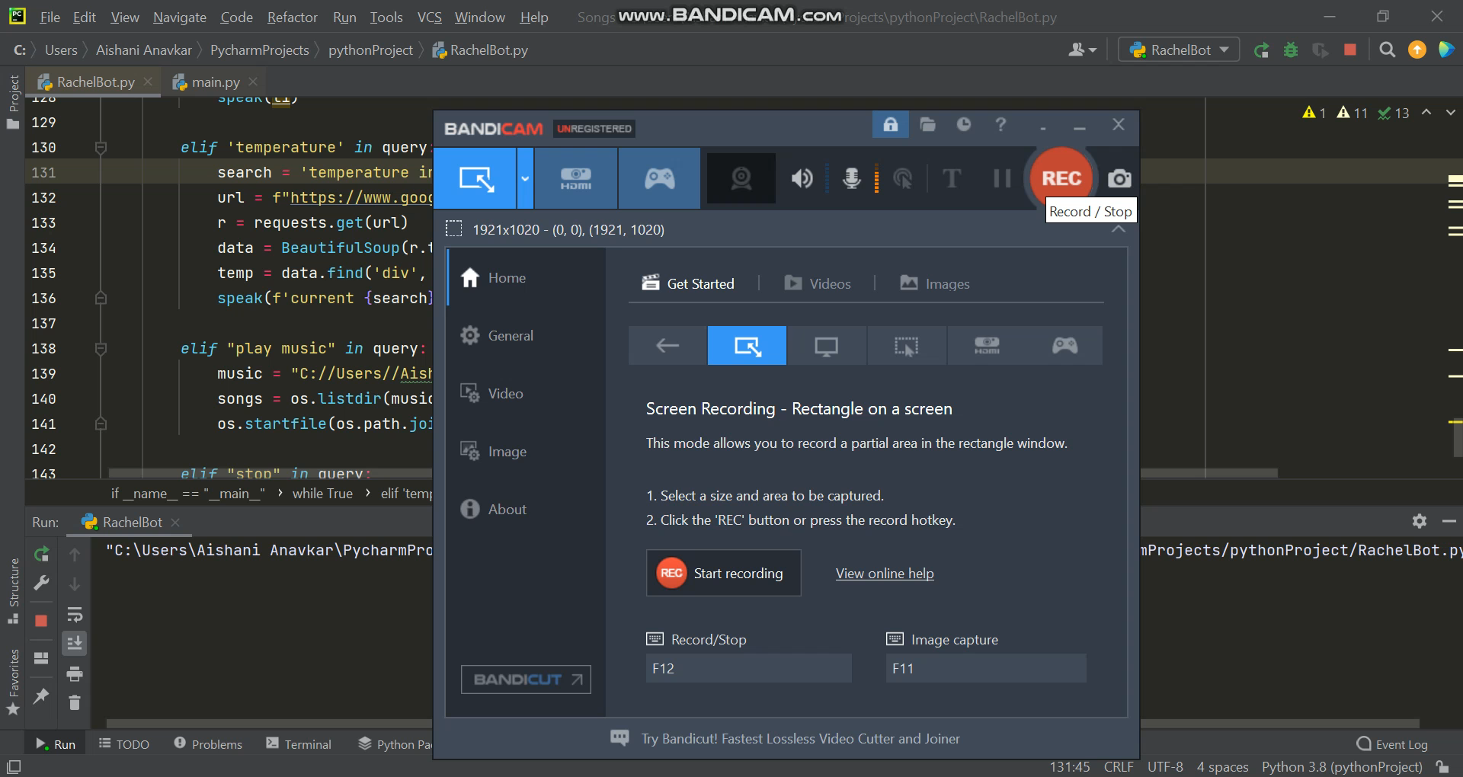

Slide 17
THANKS!
-3501 Dhruvi Swadia
-3506 Aishani Anavkar
-3519 Samriddhi Sharma
-3538 Om Bhosle
-3545 Samreen Shaikh

